Slide 1
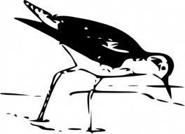

Environmental Sustainability Practices
During Construction and Maintenance Activities of the Trans Alaska Pipeline System:
Fish, Wildlife, and Vegetation
Ken Wilson
Natural Resources Program Manager
Alyeska Pipeline Service Company

Slide 2
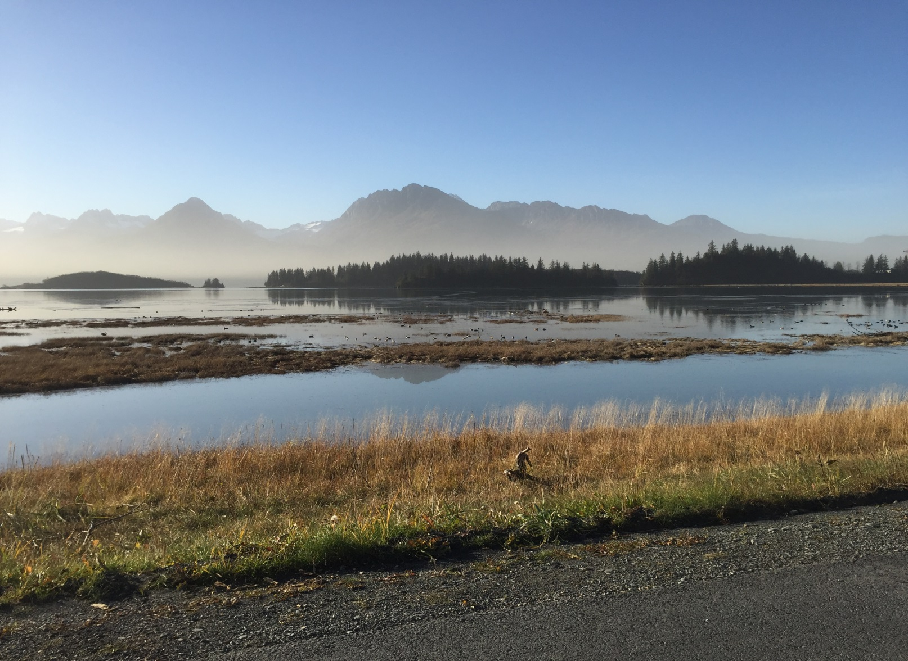
Building towards a sustainable future
Sustainability is a broad term describing: a desire to carry out activities without depleting resources or having harmful impacts.
Defined by the Brundtland Commission as “meeting the needs of the present without compromising the ability of future generations to meet their own needs.”

Slide 3
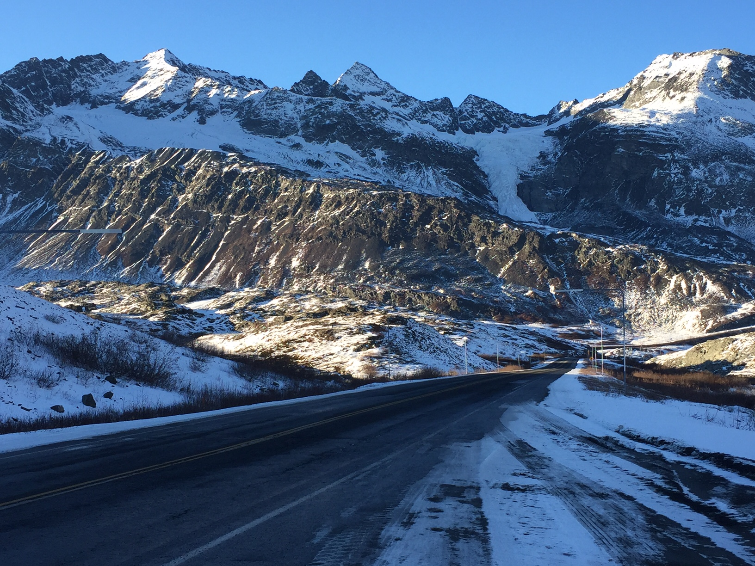
Objective: inspiration
If you care about future generations, than you care about sustainability.
What can you do in your present job role to minimize the ecological footprint of your activities?
The Take Home: Can you do your job and protect what we love about Alaska?

Slide 4

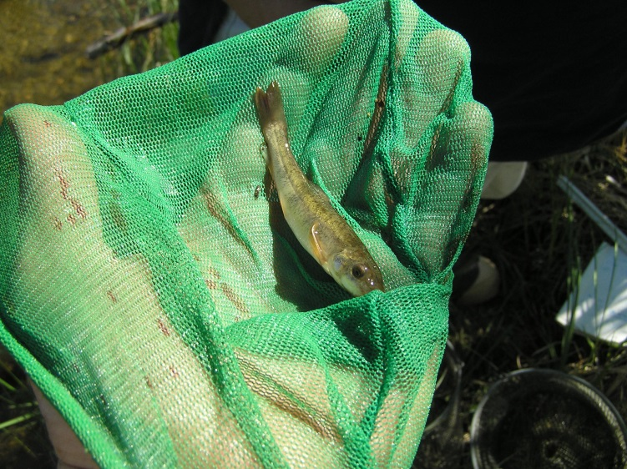
Part
1 of 3
How Do We Ensure there are abundant Fish for Future Generations

Slide 5
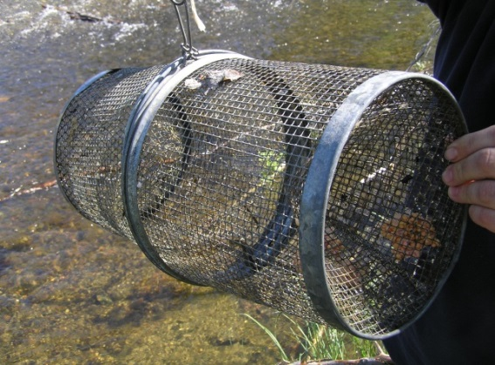
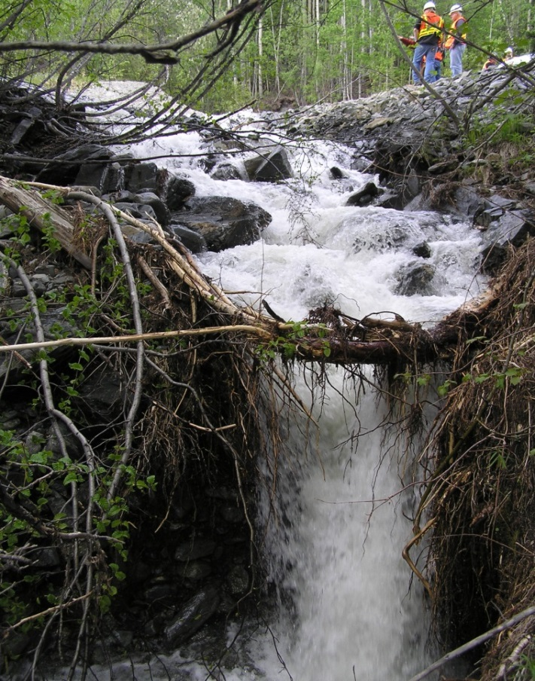
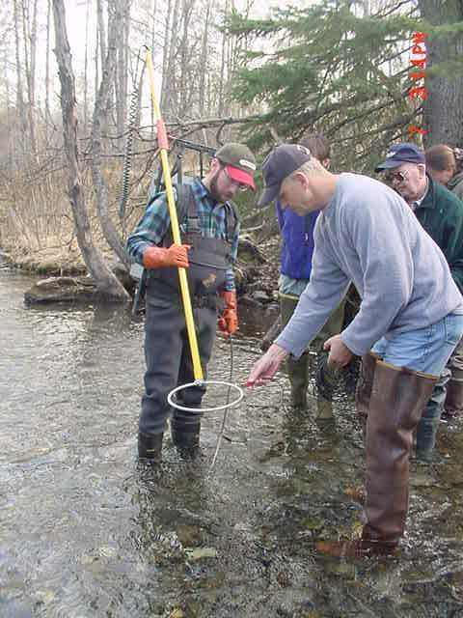
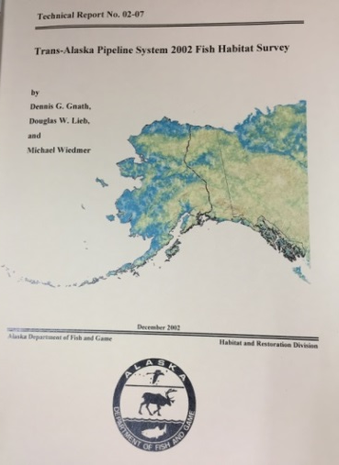
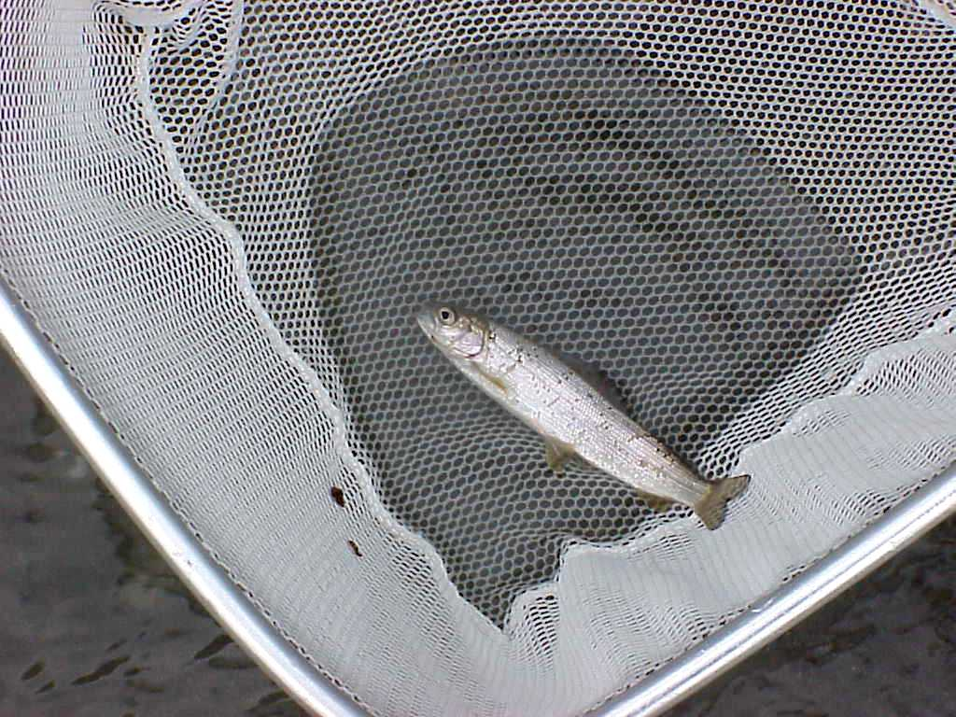
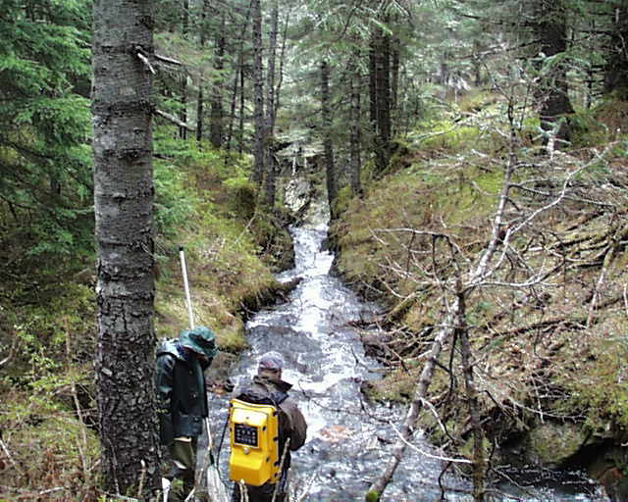
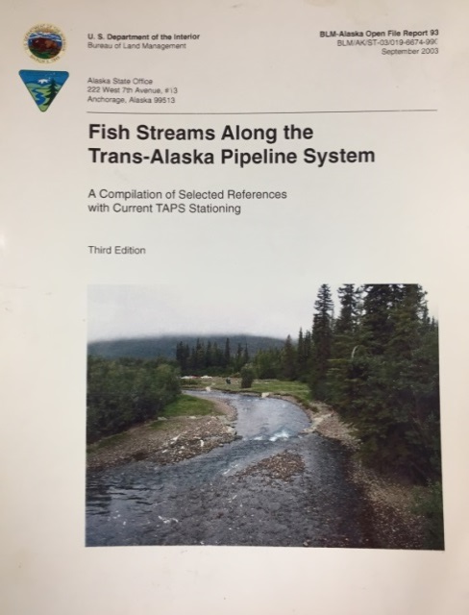
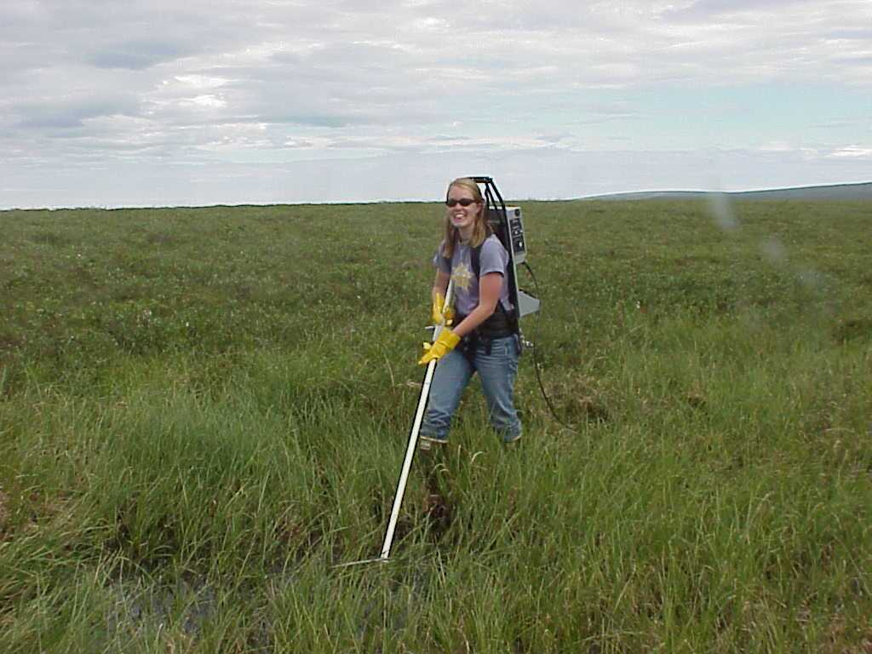

Protecting Fish: Knowing what’s there

Slide 6
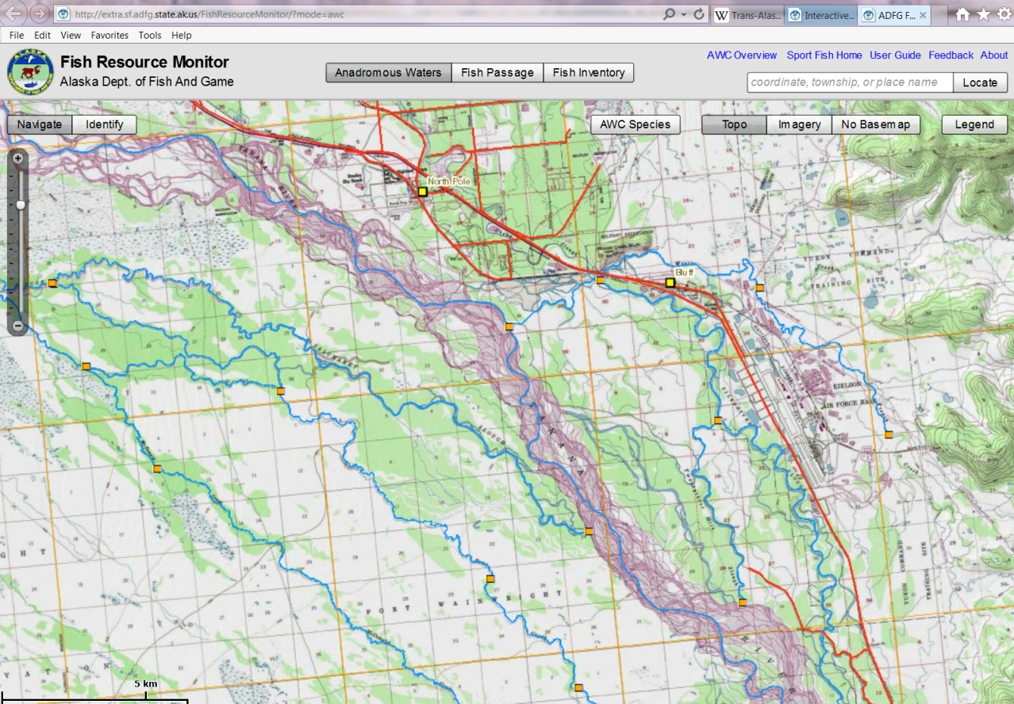
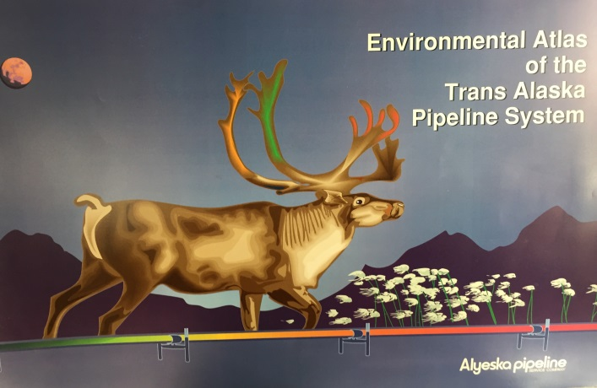
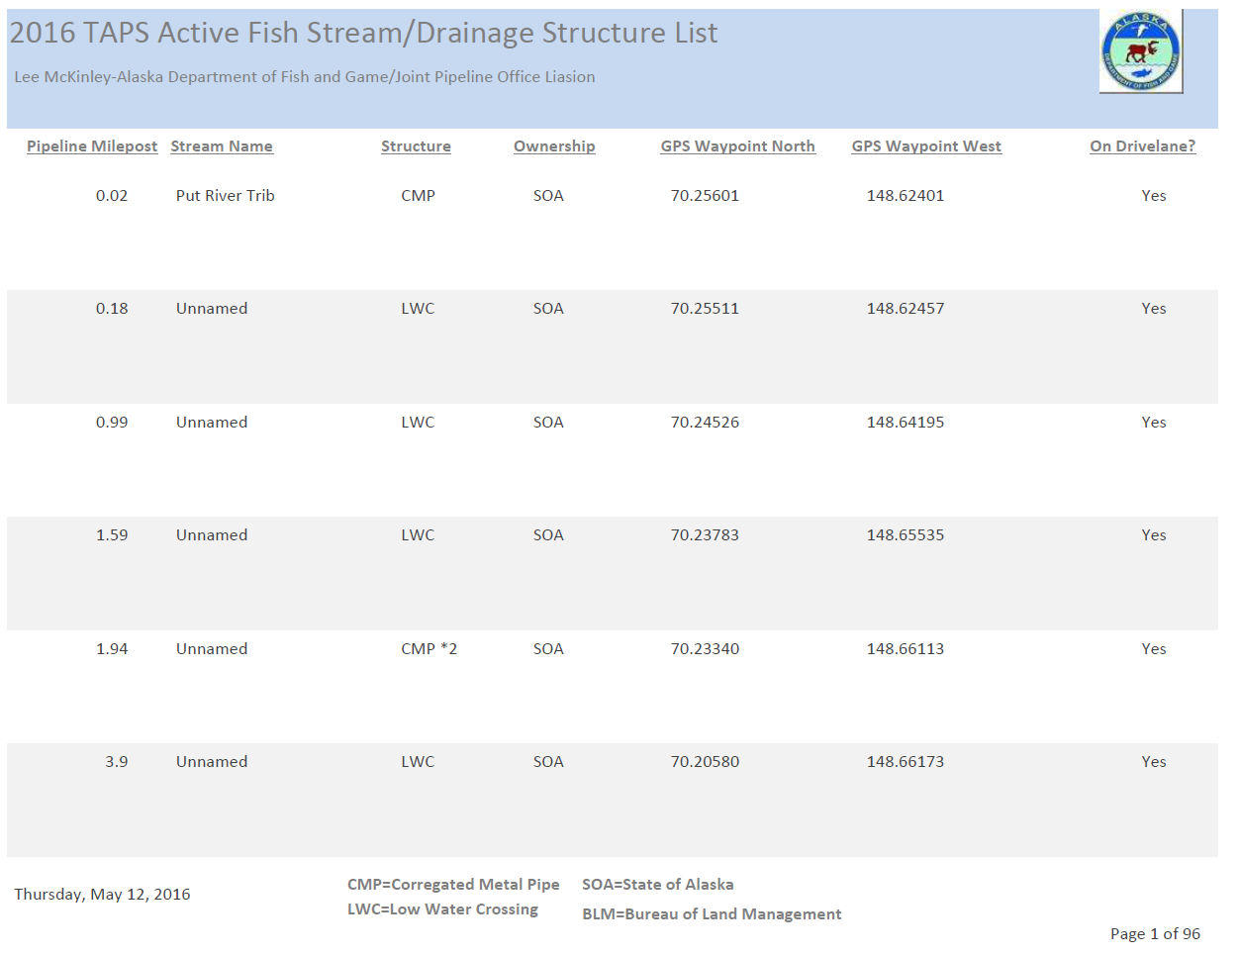
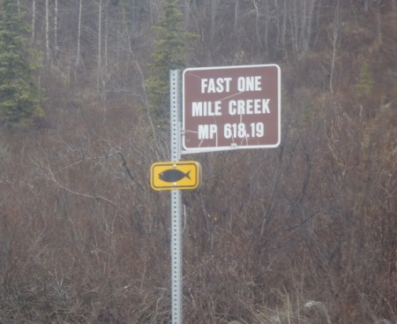

Slide 7
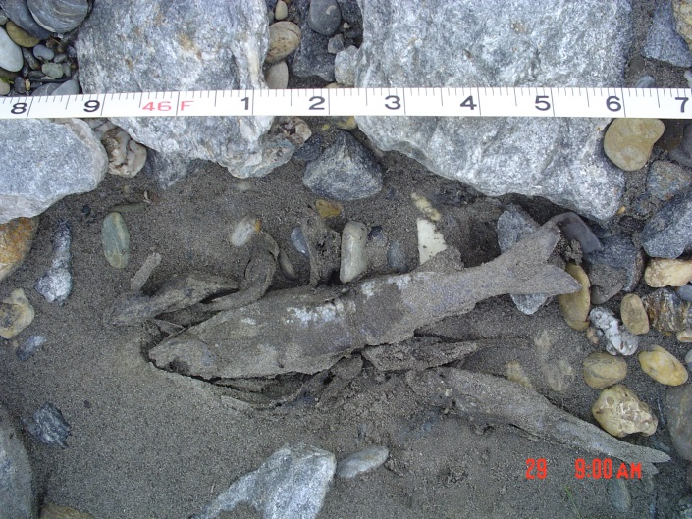
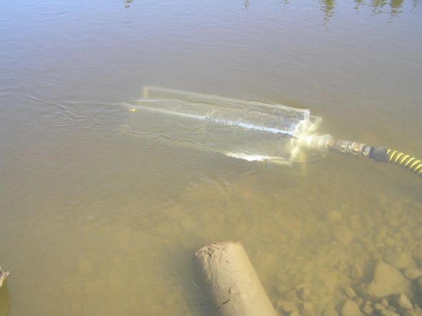
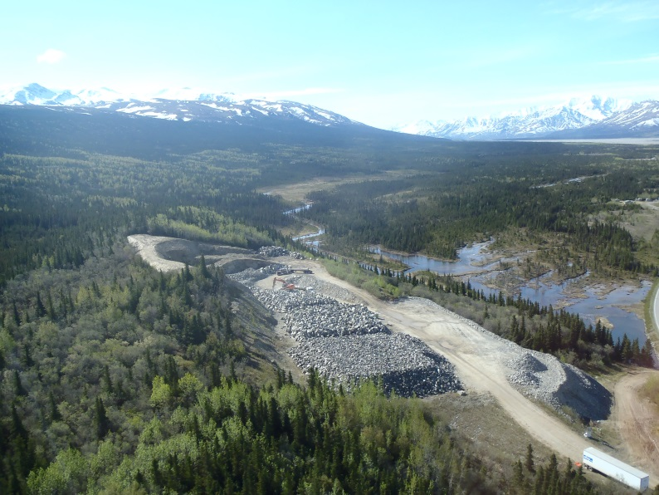
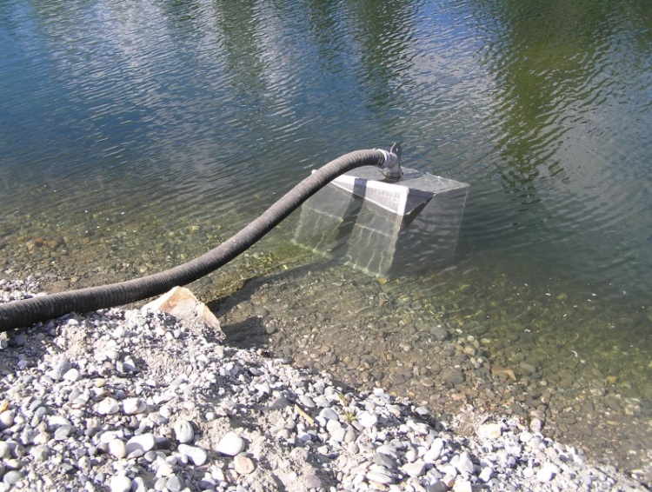

Protecting fish from direct harm:
Blasting Standards
Screened Water Intakes
Prevent Stranding
Avoid French Draining

Slide 8
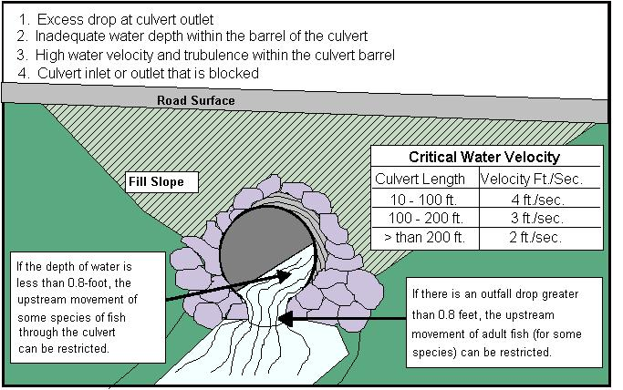
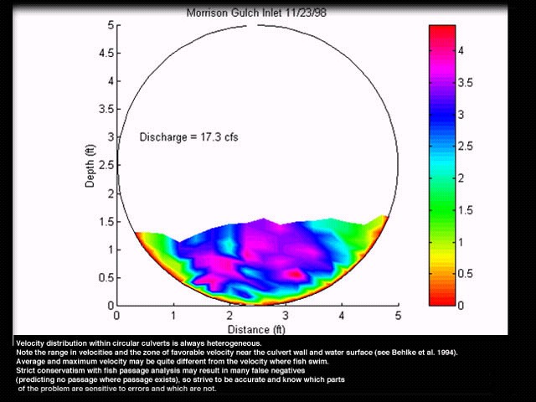
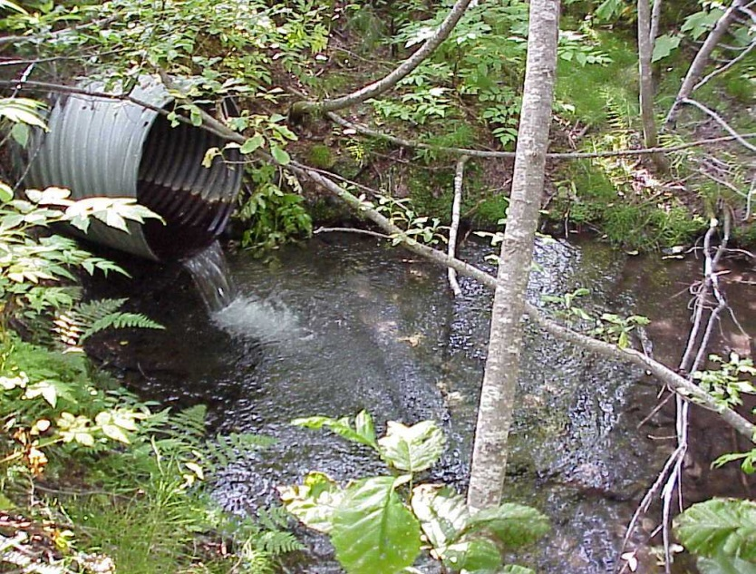
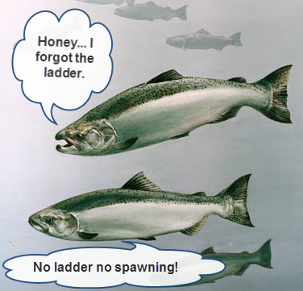
Allowing Fish Passage: Culverts

Slide 9
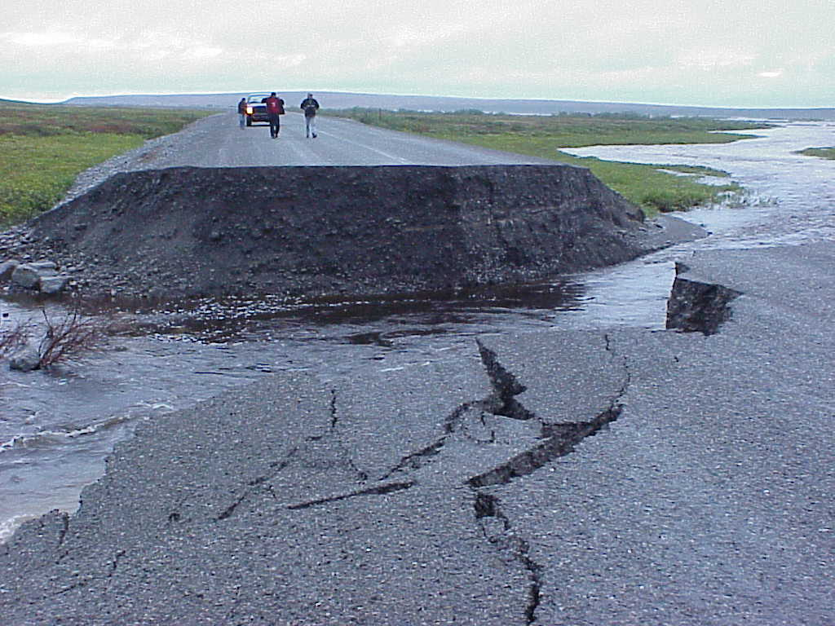
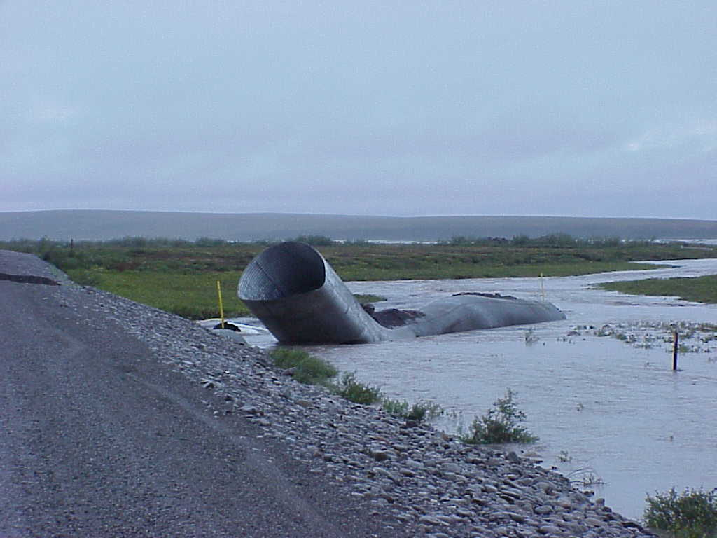
Allowing Fish Passage: Culverts

Slide 10
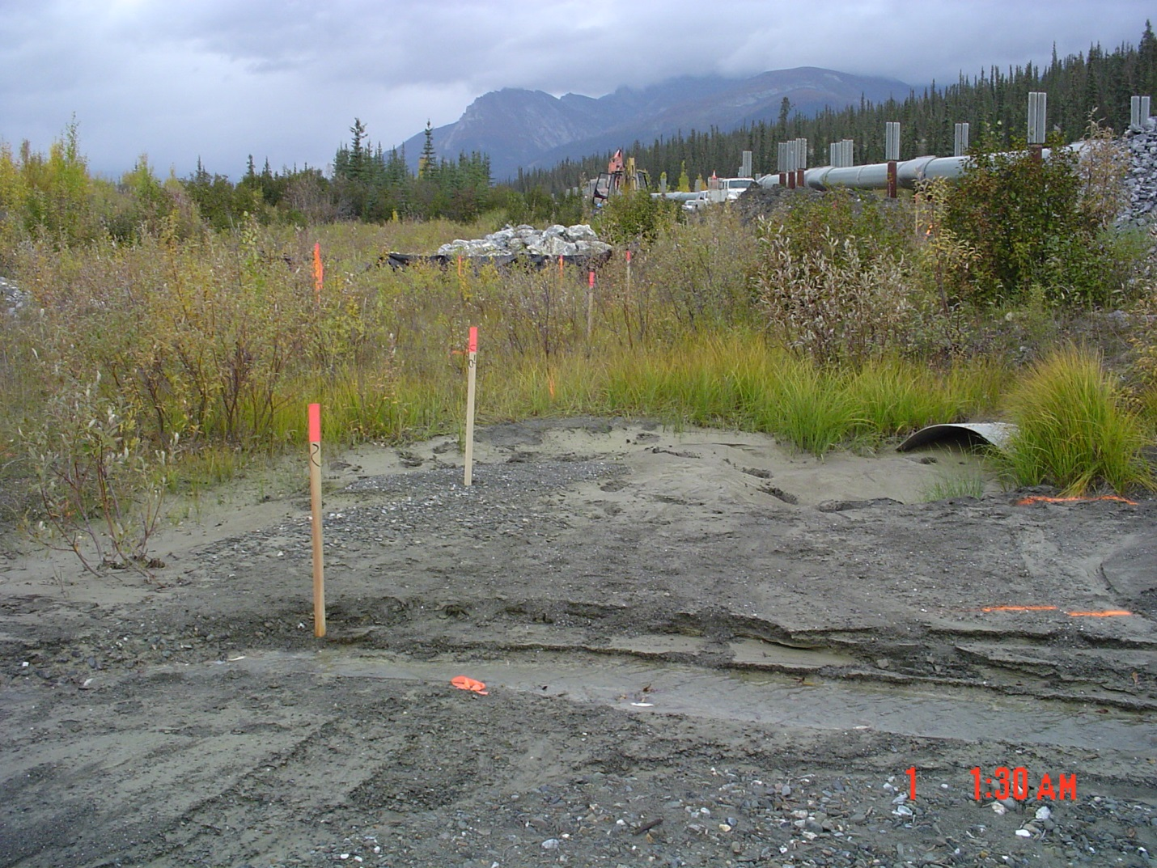
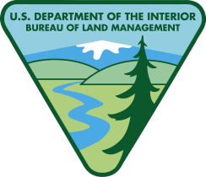
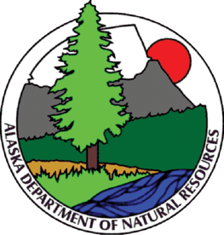
Allowing Fish Passage: Culverts

Slide 11
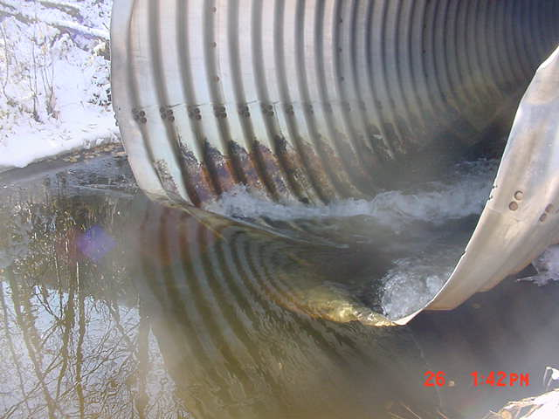
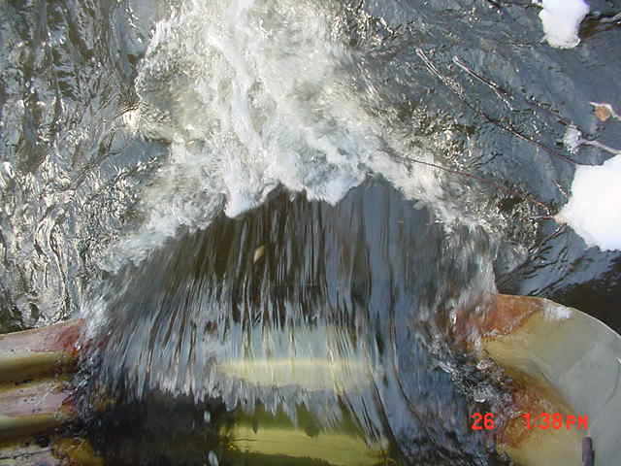
Allowing Fish Passage: Culverts

Slide 12
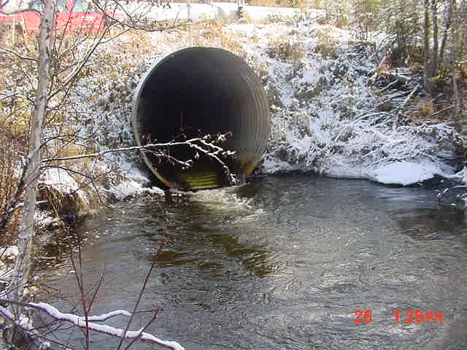
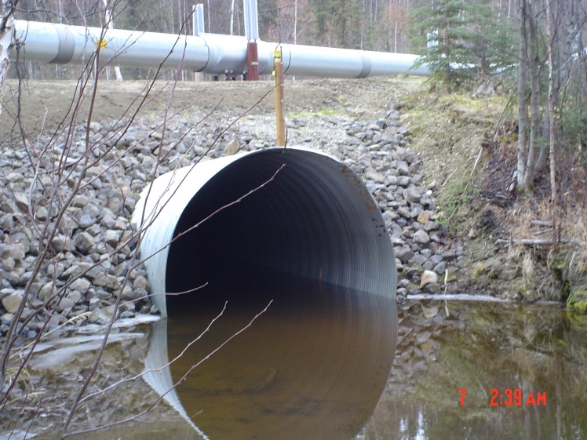
Allowing Fish Passage: Culverts

Slide 13
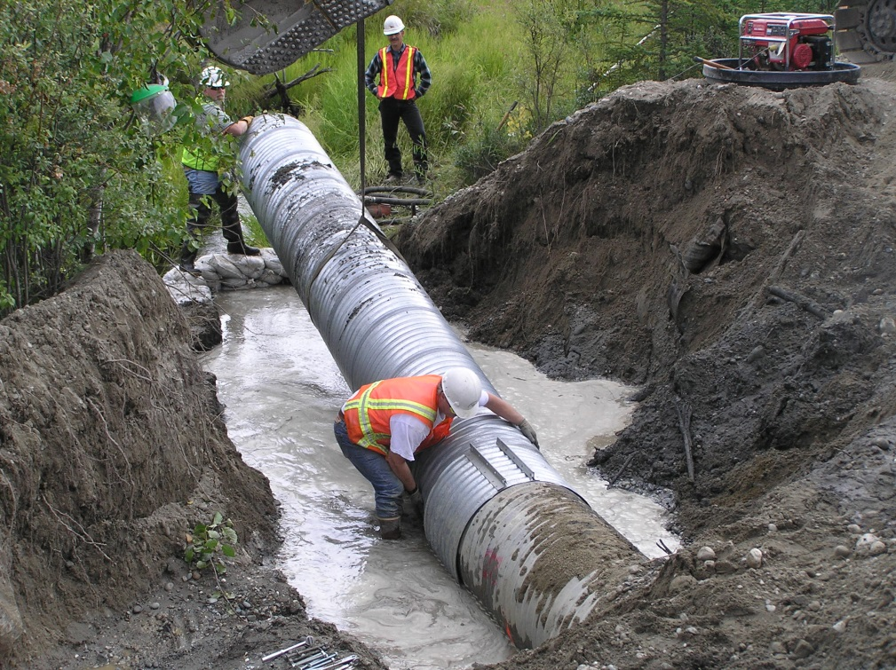
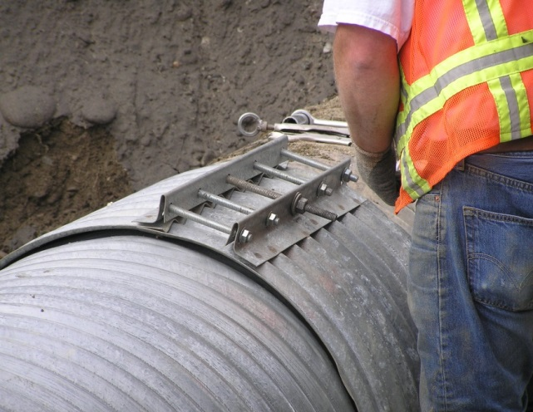
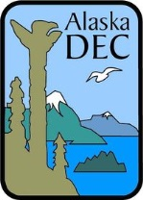


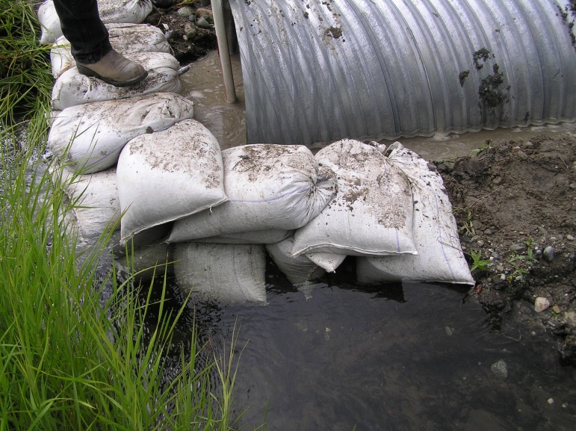
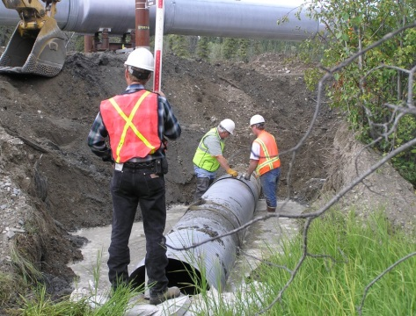
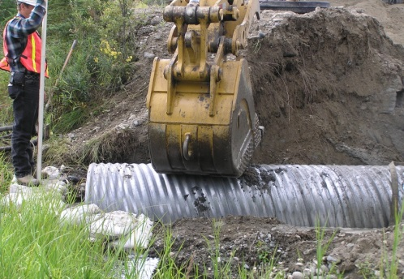
Allowing Fish Passage: Culverts

Slide 14
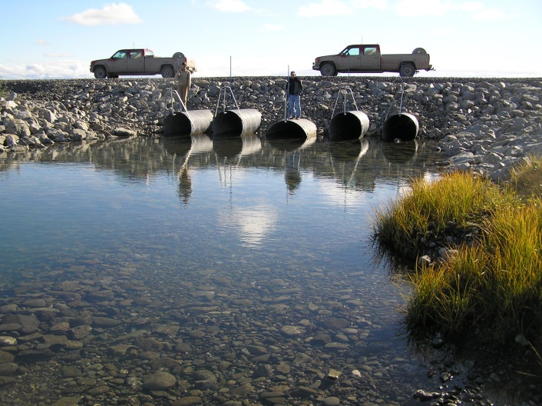

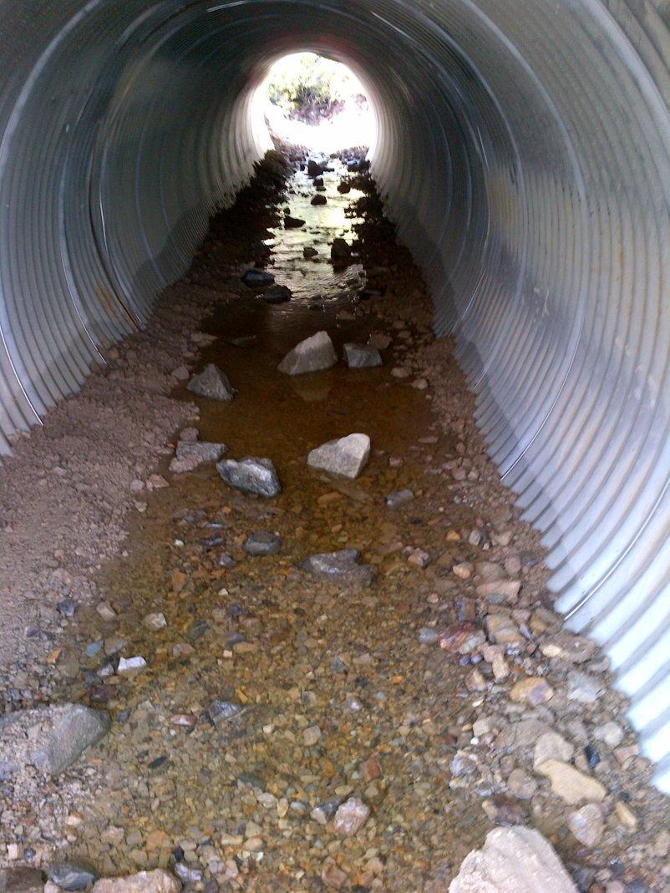
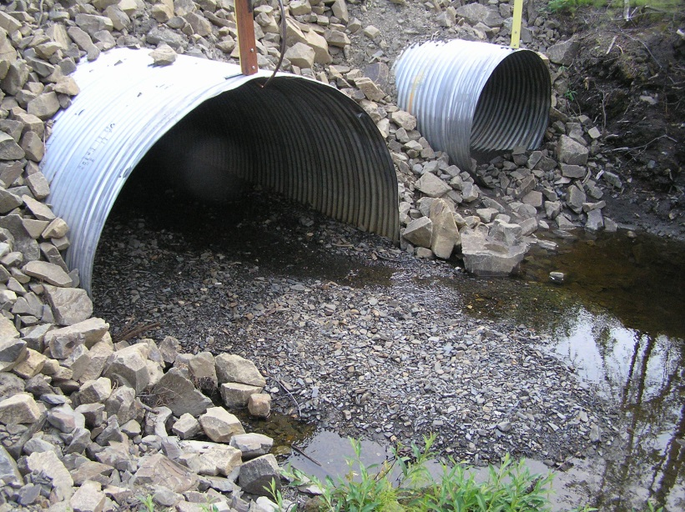
Allowing Fish Passage: Culverts

Slide 15
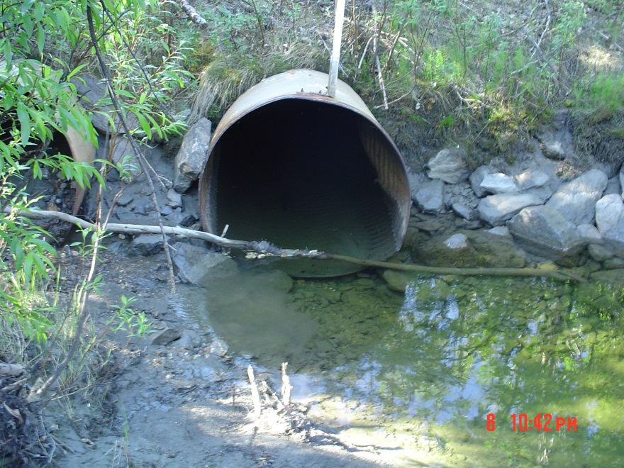
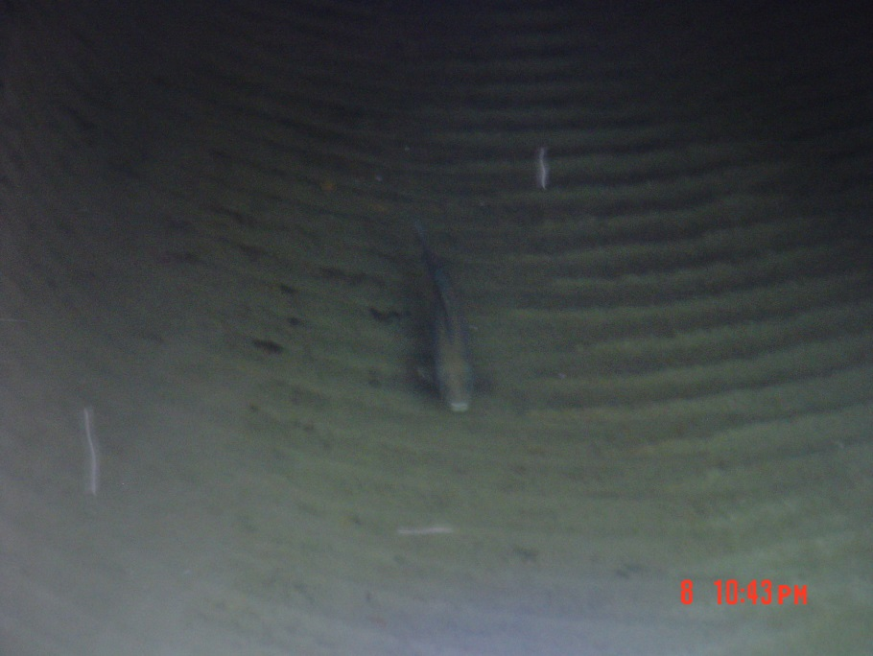
Allowing Fish Passage: Culverts

Slide 16
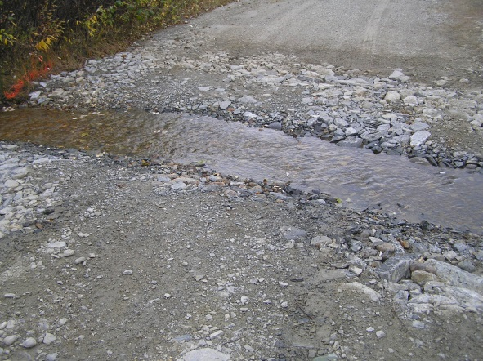
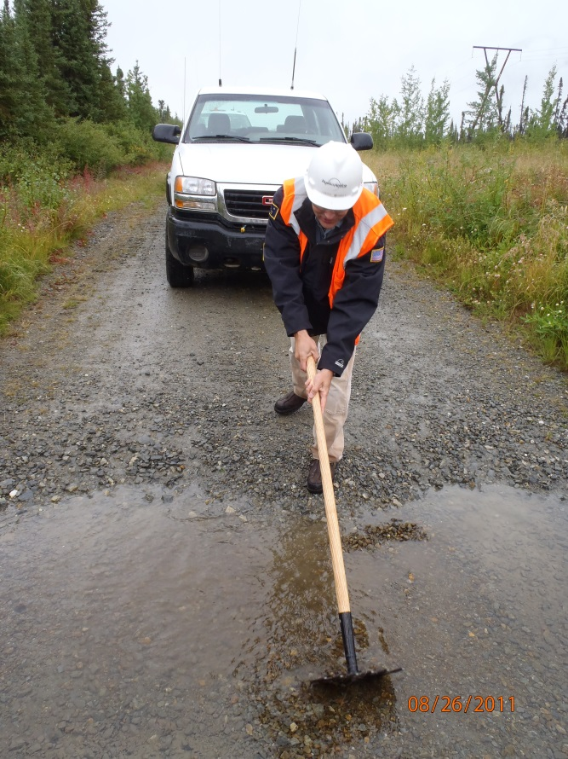
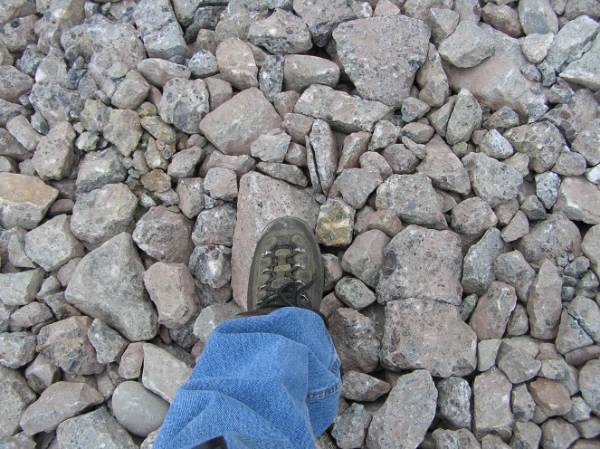
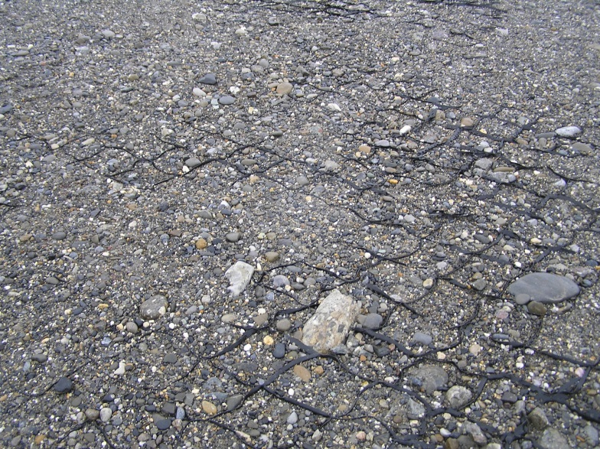
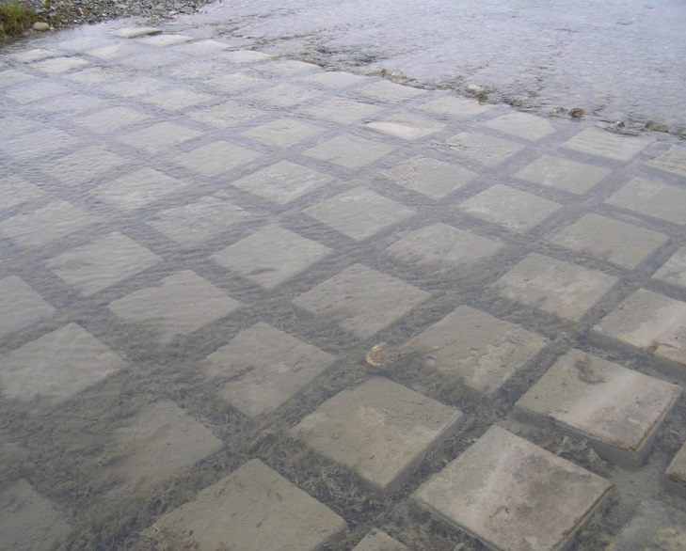
Allowing Fish Passage: Low Water Crossings

Slide 17
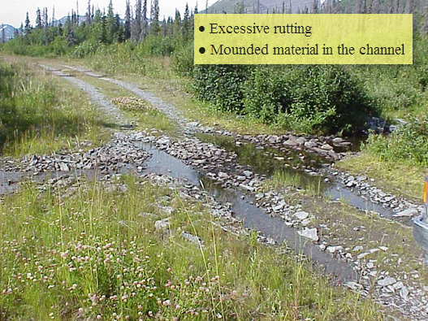



Allowing Fish Passage: Low Water Crossings

Slide 18




Allowing Fish Passage: Bridges

Slide 19




Allowing Fish Passage: Stream Geometry

Slide 20




Maintaining Fish Habitat

Slide 21

Maintaining Fish Habitat

Slide 22




Maintaining Fish Habitat

Slide 23

Maintaining Fish Habitat

Slide 24


Maintaining Fish Habitat

Slide 25






Protecting Water Quality

Slide 26
Protecting fish: summary
Know What Fish Species are Present
  Use Existing Information in Planning; Conduct Field Surveys if Needed
  Time your Project to Avoid Sensitive Periods
Protect Fish from Direct Harm
  Follow Blasting Standards
  Use Screened Water Intakes
  Prevent Stranding: capture and remove fish from isolated work areas, provide bypass structures
  Avoid French Draining
Allow Fish Passage
  Ensure Proper installation of Drainage Structures
  Conduct Surveillance and Maintenance throughout life of Drainage Structure
  Understand the Impact of Channel Geometry Upstream and Downstream of Work Area
Maintain Fish Habitat
  Protect Spawning and Overwintering Habitats
  Maintain Rearing and Migration Areas
  Use Habitat Restoration Methods for Disturbed Areas
Protect Water Quality
  Comply with State Water Quality Standards
  Utilize Proper Stormwater and Erosion Control Methods

Slide 27

Part
2 of 3
How Do We Ensure there is abundant wildlife for Future Generations

Slide 28







Protecting Wildlife: Knowing what’s there
http://www.asgdc.state.ak.us/
http://www.adfg.alaska.gov/index.cfm?adfg=maps.main
https://alaskafisheries.noaa.gov/mapping/esa/

Slide 29





Avoid Attracting or Entrapping Wildlife

Slide 30


Avoid Attracting or Entrapping Wildlife

Slide 31

Never allow them access to food or waste

Slide 32


Avoid Attracting or Entrapping Wildlife

Slide 33


Exclude unwanted Wildlife

Slide 34




Exclude unwanted Wildlife

Slide 35


Exclude unwanted Wildlife

Slide 36


Exclude unwanted Wildlife

Slide 37

Exclude unwanted Wildlife

Slide 38

Exclude unwanted Wildlife

Slide 39

Exclude unwanted Wildlife

Slide 40




Make them go away

Slide 41

Make them go away

Slide 42





Make them go away

Slide 43





Make Safe Places

Slide 44

Make Safe Places

Slide 45




Allow Free Passage

Slide 46



Allow Free Passage

Slide 47



Protect Important Habitat

Slide 48



Is it possible to Co-exist?

Slide 49


Is it possible to Co-exist?

Slide 50

Is it possible to Co-exist?

Slide 51




Is it possible to Co-exist?

Slide 52


Is it possible to Co-exist?

Slide 53



Is it possible to Co-exist?

Slide 54



skill to capture and transport if needed

Slide 55



skill to capture and transport if needed

Slide 56



skill to capture and transport if needed

Slide 57



skill to capture and transport if needed

Slide 58


skill to capture and transport if needed

Slide 59






skill to capture and transport if needed

Slide 60




skill to capture and transport if needed

Slide 61

Protect Human Life and Property

Slide 62

Protect Human Life and Property

Slide 63
Protecting Wildlife: summary
Know What Wildlife Species are Present
  Use Existing Information in Planning; Conduct Field Surveys if Needed
  Time your Project to Avoid Sensitive Periods
Avoid Attracting or Entrapping
    The Most Important Thing You Can Do
Never Allow Them Access to Food or Waste
  The Most Important Thing You Can Do
Exclude Unwanted Wildlife
Make Them Go Away
  Haze/Deter
Make Safe Places
  Where do you expect them to go?
Allow Free Passage
  Who has the right-of-way?
Protect Important Habitat
  Keep Certain Activities out of Sensitive Areas
Find Ways to Co-Exist
  Can “Urban Wildlife” and Human Activities Overlap?
Capture and Transport if Needed
Protect Human Life and Property

Slide 64

Part
3 of 3
How do we Protect Vegetation and Habitats

Slide 65

Protecting Vegetation:
During Design and Planning
Avoidance of sensitive areas, subsistence use areas, high value recreation and scenic areas
Use of GIS Mapping in site planning to identify in advance sensitive, subsistence and scenic areas as well as areas of potential impacts
Select best time of year to avoid or minimize impact

Slide 66

Protecting Vegetation:
During Design and Planning

Slide 67


Protecting Vegetation:
During implementation

Slide 68






Protecting Vegetation:
Temporary Structures

Slide 69


Protecting Vegetation:
During implementation

Slide 70




Protecting Vegetation:
During implementation

Slide 71


Protecting Vegetation:
During implementation

Slide 72



Protecting Vegetation:
after implementation

Slide 73


Protecting Vegetation:
after implementation

Slide 74


Protecting Vegetation:
after implementation

Slide 75



Protecting Vegetation:
Frozen Conditions

Slide 76


Protecting Vegetation:
Brush Clearing

Slide 77




Protecting Vegetation:
Equipment Selection

Slide 78





Protecting Vegetation:
Minimizing Potential for Spills

Slide 79


Use Weed Free Seed and other Products

Slide 80



Control Erosion and Sedimentation

Slide 81




Control Erosion and Sedimentation

Slide 82


Control Erosion and Sedimentation

Slide 83





Revegetation

Slide 84






Revegetation In Riparian Habitats

Slide 85

Revegetation In Riparian Habitat: After

Slide 86

Revegetation In Moose Habitat Before

Slide 87


Revegetation In Moose Habitat: During

Slide 88

Revegetation In Moose Habitat:
8 years Later

Slide 89



Revegetation In Moose Habitat:
8 years Later

Slide 90




Revegetation In Ice Rich Permafrost: Before

Slide 91


Revegetation In Ice Rich Permafrost: During

Slide 92



Revegetation In Ice Rich Permafrost: 3 Years Later

Slide 93


Revegetation at Alpine Stream

Slide 94


Revegetation In High Alpine Area:
2 Years Later

Slide 95

Revegetation For Major River and Floodplain Projects

Slide 96




Revegetation For Major River and Floodplain Projects

Slide 97


Revegetation For Major River and Floodplain Projects

Slide 98



Revegetation For Major River and Floodplain Projects

Slide 99

Revegetation For Major River and Floodplain Projects

Slide 100


Revegetation For Major River and Floodplain Projects

Slide 101

Revegetation For Major River and Floodplain Projects

Slide 102

Revegetation For Major River and Floodplain Projects

Slide 103
Protecting Vegetation: summary
Know What Vegetation Types and Species are Present
  Use Existing Information in Planning; Conduct Field Surveys
  Time your Project to Avoid Sensitive Periods
Minimize Footprint: less disturbed=less restoration needed
  Plan your traffic patterns
Use Methods to Protect Vegetative Mat
  Tundra mats, frozen soil, ice roads, brush cutting rather than grubbing
Use Weed Free Seed and Other Products
  Use Annual Grass Seed instead of Perennial
Control Erosion and Sedimentation
Revegetate
  Define Clear Goals and Endpoints in Advance
  Identify the specific techniques required for the site
  Save and re-spread organic soil, use transplants, use cuttings, cover riprap
  Monitor Progress

Slide 104
Part
4 of 3
THIS IS HOW We Protect Fish, Wildlife, and habitats:
Us
(Hint: “You”)

Slide 105


Awareness
Notes:
Decoys: Bird and otter decoys are placed in advance along the shoreline, or released in the water during the drill.

Slide 106



Training

Slide 107


Slide 108


Buy In: Agreed Goals
Notes:
Decoys: Bird and otter decoys are placed in advance along the shoreline, or released in the water during the drill.

Slide 109
Buy In: Agreed Goals
Visit the Site when planning!
Notes:
Decoys: Bird and otter decoys are placed in advance along the shoreline, or released in the water during the drill.

Slide 110

Talking out the specifics

Slide 111


Hard Work
Notes:
Decoys: Bird and otter decoys are placed in advance along the shoreline, or released in the water during the drill.

Slide 112



Recognition

Slide 113
Building towards a sustainable future
It’s in Your Hands

